Slide 1


KIET group of institution
KIET Group of Institutions, Ghaziabad
(An ISO – 9001: 2008 Certified & ‘A+’ Grade accredited Institution by NAAC
Guide Name :- Mr. Abhishek Goyal
Team Members :- Avi Chaudhary (2000290120048)
Avika Tyagi ((2000290120049)
Ankita Kushwaha (2000290120026)
Project Id:- PCS24-11

Slide 2

AIR POLLUTION FORCASTING

Slide 3
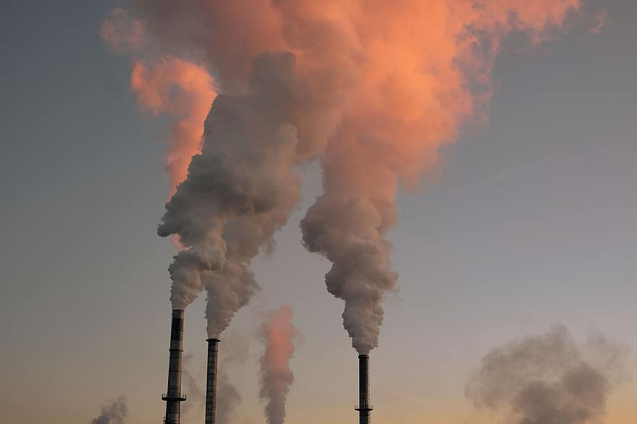
Content:
Problem.
The importance of the project.
The goal of the research.
Methods used to predict.
System Architecture.
Conclusion.
Future work

Slide 4
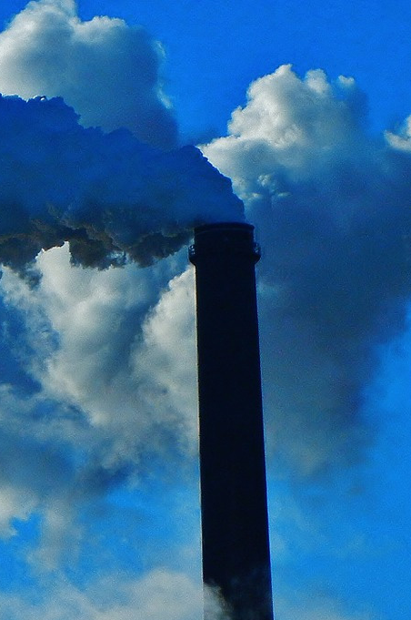
Problem
Most major cities suffer from high concentrations of air pollutants at the ground level, so regulating air pollution levels has become one of the most important tasks for governments in developing countries.

Slide 5
importance
Great impact on human health and ecosystems.
Air pollution degrades air quality and leads to many diseases, most notably asthma.

Slide 6

Goal of the research:
This research aims to predict the level of air pollution with a set of data used to make predictions through them and to obtain the best prediction using several models and compare them and find the appropriate solution.

Slide 7
Methods used to predict:
1.
2.
3.
Multiple Linear Regression
Feedforward Neural Network Based on Back Propagation
Extreme Learning Machine

Slide 8

Multiple Linear Regression
Multiple Linear Regression (MLR) models are trained on the basis of current measurements.
It used to predict the future concentrations of air pollutants in accordance with meteorological variables.

Slide 9
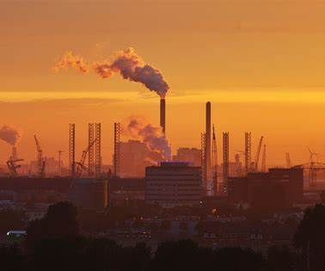
FFANN-BPs:
Possesses the advantages of integrating complex non-linear relationships between the concentration of air pollutants and corresponding meteorological variables.
They are widely used to predict the concentration of air pollutants.

Slide 10

ELM:
The best method:
It has a stronger circulation than conventional statistical methods and ANN with maximum learning speed.

Slide 11

Laws using:

Slide 12

SYSTEM ARCHITECTURE

Slide 13
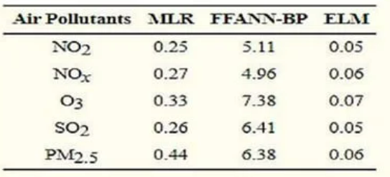
Training period:
ELM has the best performance​

Slide 14

The best Method is which has a height value of R2 and a low value of RMSE.

Slide 15

Conclusion:
In this paper , we proposed to predict the concentration of air pollutants on the basis of ELM, where the best performance was performed on safety prediction indicators such as R2, RMSE , etc. The present study revealed that ELM performs slightly better than simple statistical techniques.

Slide 16
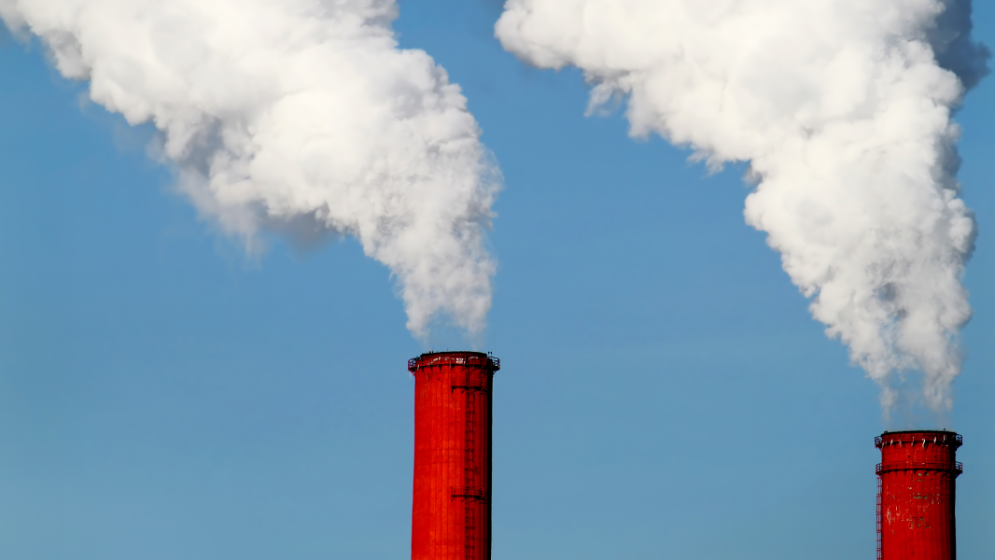
Future work
In the future, we plan to analyse correlations between sensing sites located close to each other to uncover latent similarities in pollutant or AQI patterns and to analyse if they are influenced by other environment factors such as green cover or traffic. We also plan to further extend the analysis of impact on air quality from different types of sensing areas across different cities. Another future work is to infer the latent diurnal and seasonal pollution data patterns in different parts of a city according to its built environment.

Slide 17

Thank you

